Slide 1
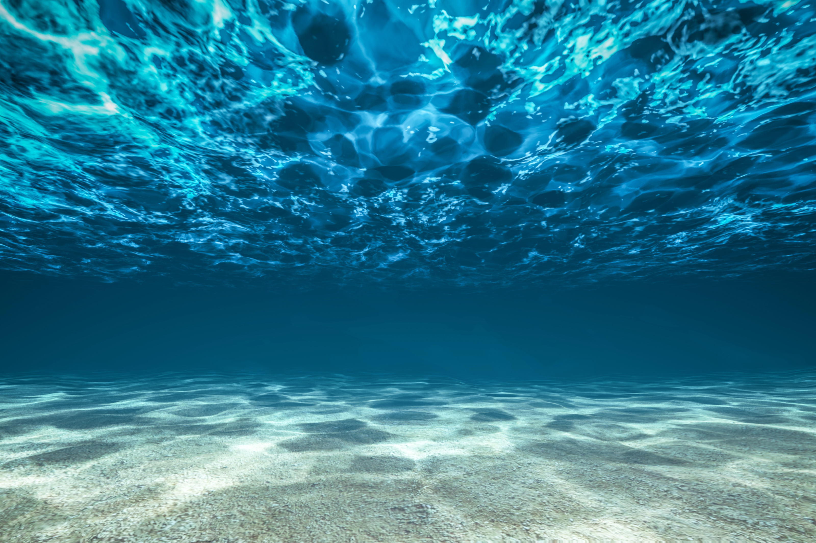
Testbed for IoUT
Felipe Bahamondes, Mathias Markvardsen, Morten Henriksen

Slide 2
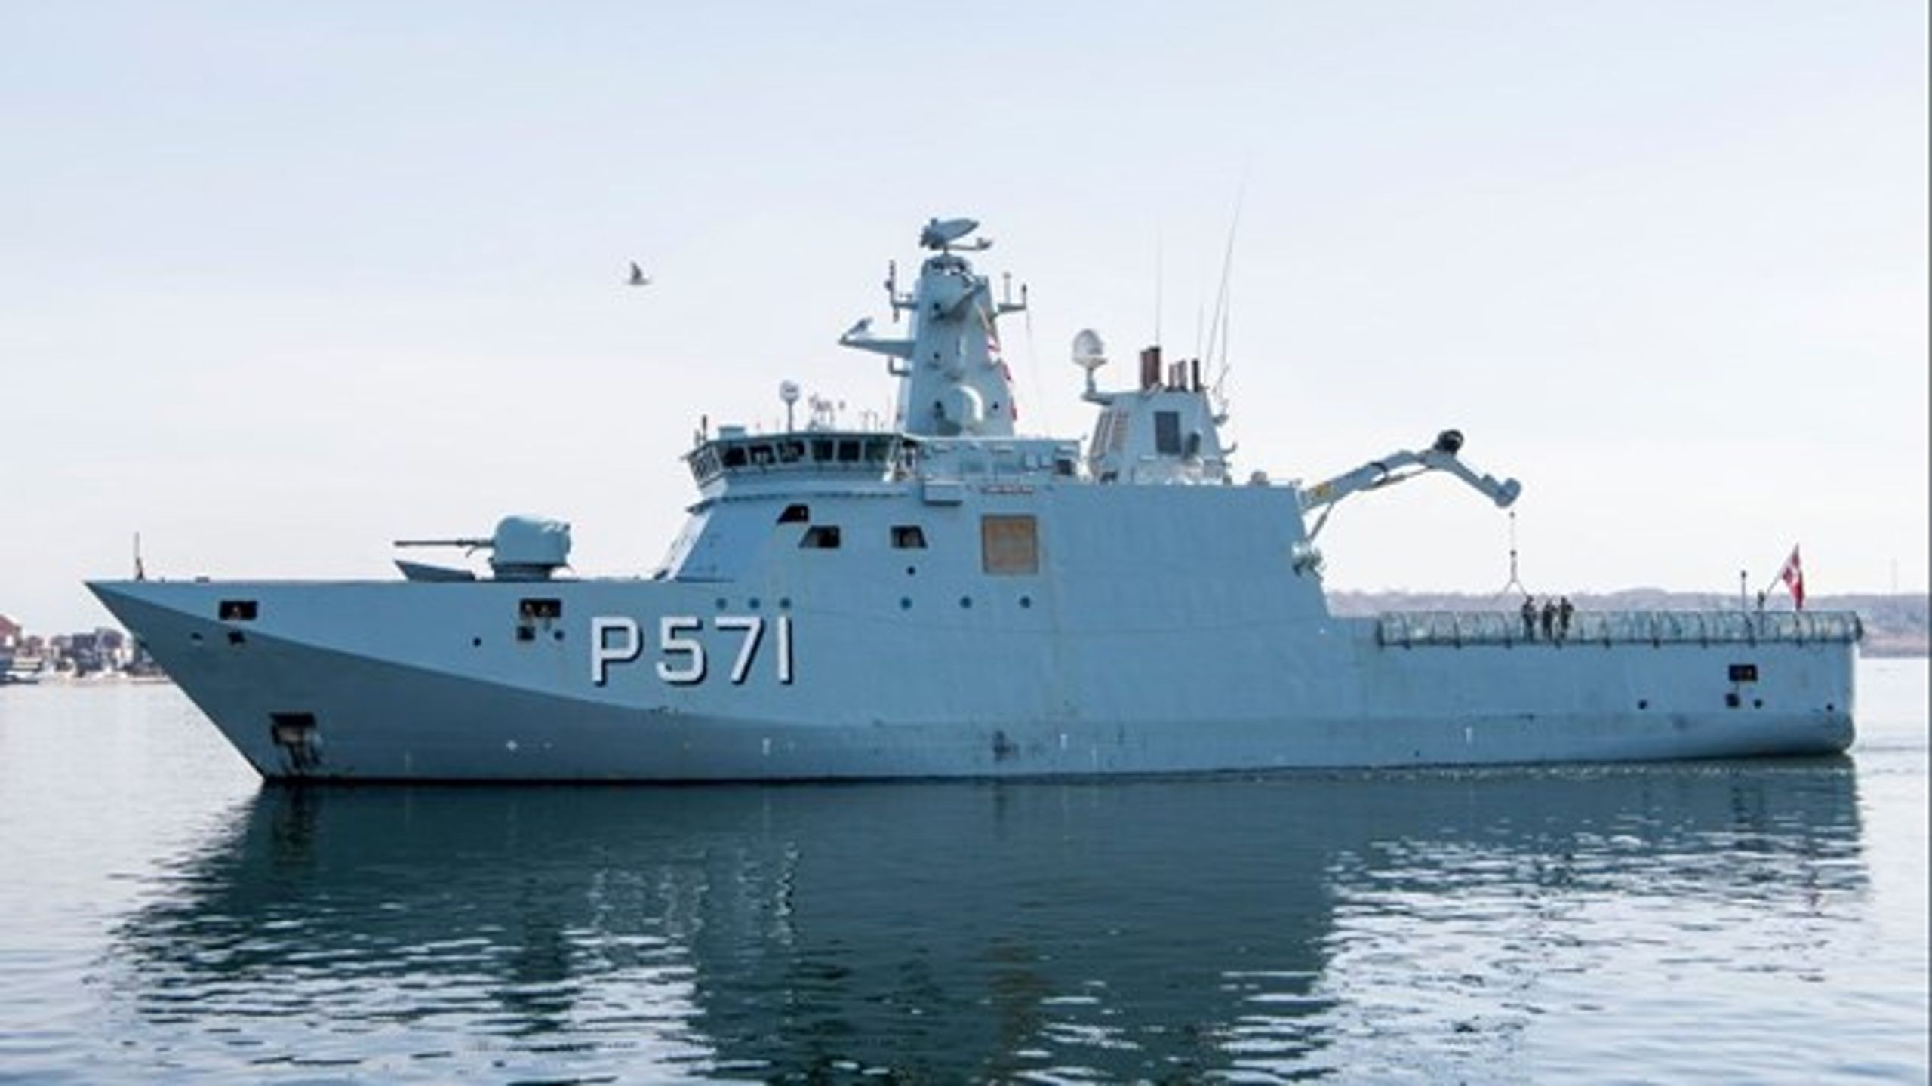
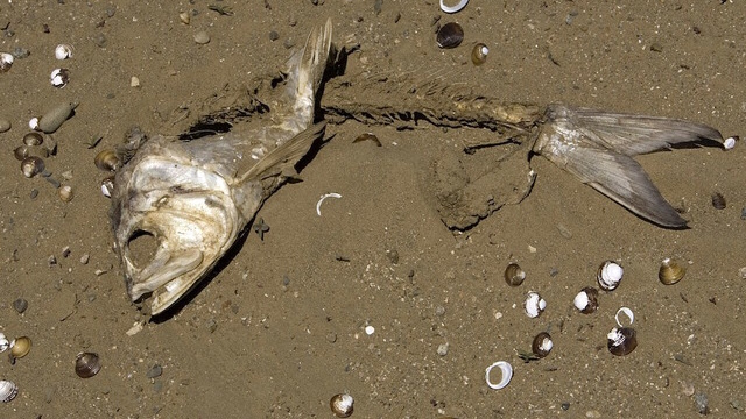
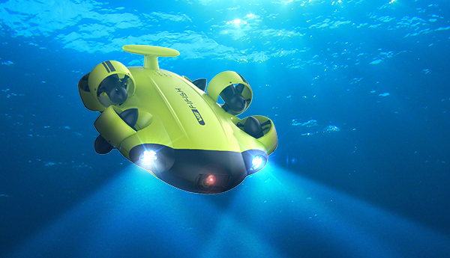
Motivation
To facilitate a test bed that will act as reference frame for researchers to compare their innovations

Slide 3

Status
Stage 1 -
Successfully transmitted data across our plastic tank
Stage 2 -
Replace expensive components from Stage 1 with cheaper alternatives
Stage 3
Use Stage 2 results for real world application

Slide 4
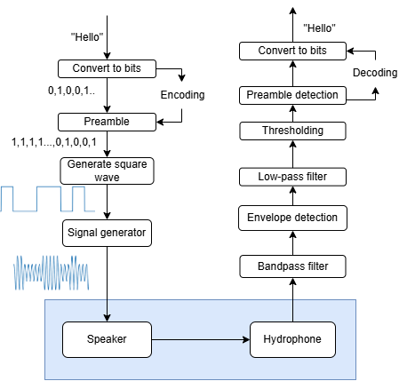
Stage 1 pipeline

Slide 5
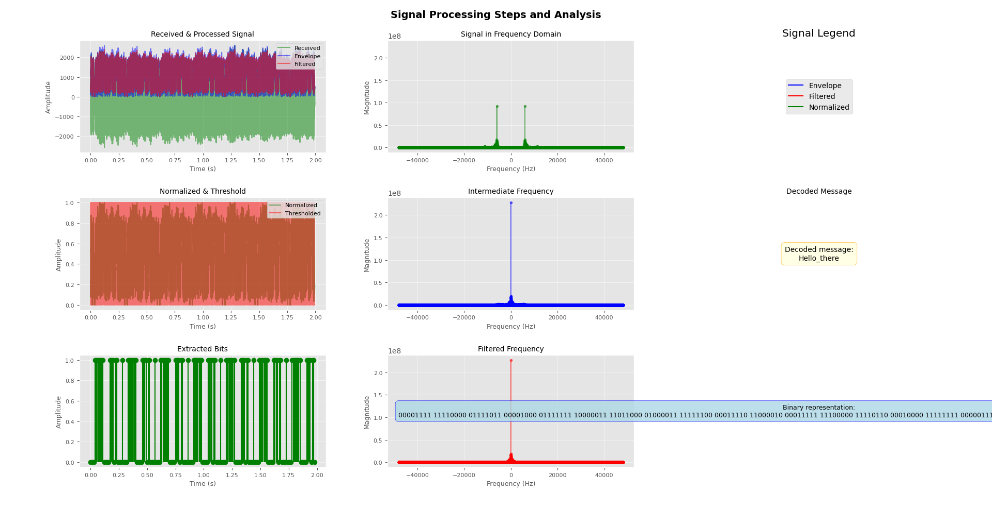

Slide 6
TO THE POOL !
(Tomorrow)
Recreate the same tests over longer distances (6 m)

Slide 7
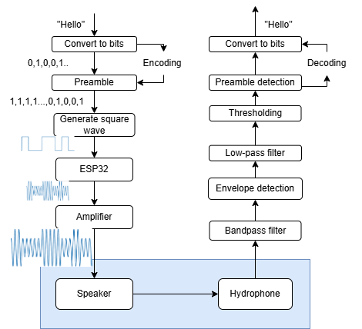
Stage 2 pipeline

Slide 8
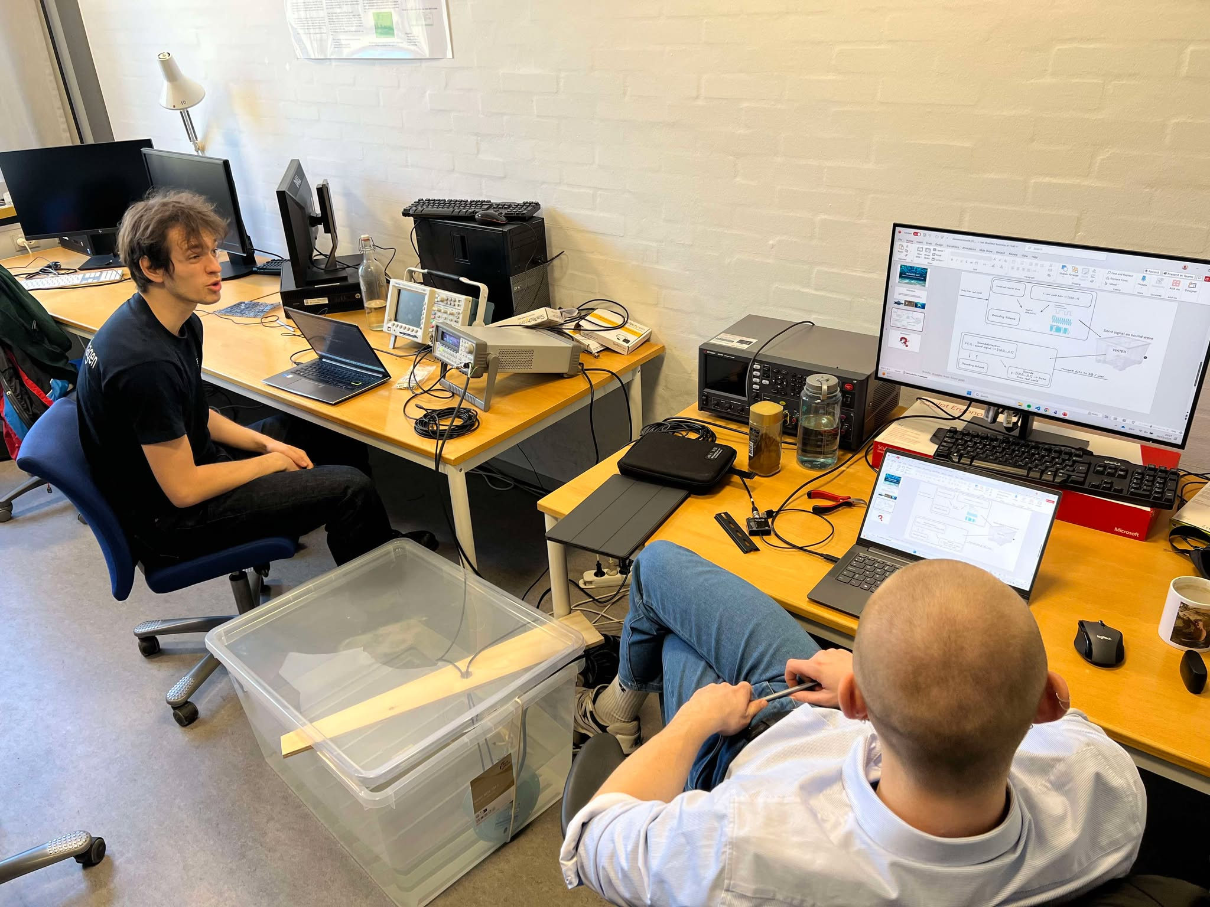

Questions?

